Slide 1

Chapter 5 - DATA TYPES

Slide 2
Introduction
A data type defines a collection of data objects and a set of predefined operations on those objects
- Possible values
- Possible transitions
A descriptor is the collection of the attributes of a variable
- Usually used at compile time
- Sometimes available at run-time

Slide 3

Primitive Data Types
Almost all programming languages provide a set of primitive data types
Primitive data types: Types, values of which can be expressed by primitive values.
Some primitive data types are merely reflections of the hardware
Others require little soft support

Slide 4
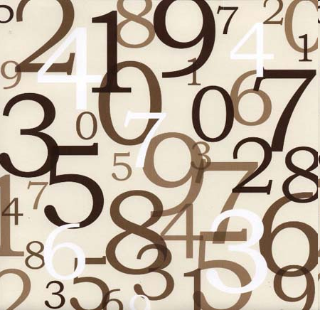
Primitive Data Types: Integer
Almost always an exact reflection of the hardware
There may be as many as eight different integer types in a language
Java’s signed integer sizes: byte, short, int, long

Slide 5

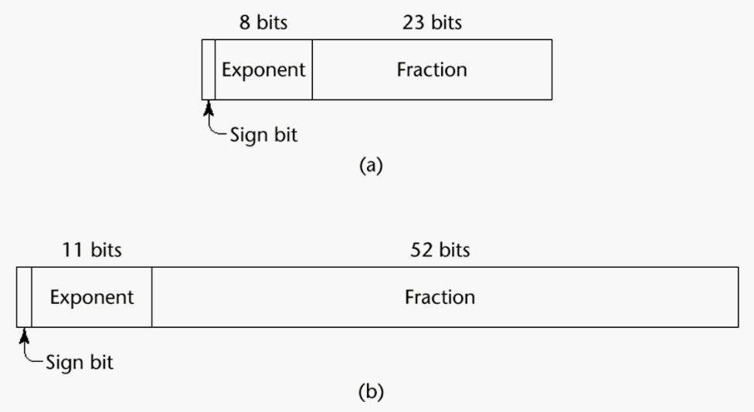
Primitive Data Types: Floating Point
Model real numbers, (as approximations)
Is the computer realization of the scientific notation.
Usually supported by hardware, but not always
IEEE Floating-Point
Standard 754

Slide 6
Precision of Floating Point Numbers
the decimal number 0.1 is not representable in binary floating-point of any finite precision;
the exact binary representation would have a "1100" sequence continuing endlessly:
  e = −4; s = 1100110011001100110011001100110011...,
  which is actually 0.100000001490116119384765625 in decimal.

Slide 7
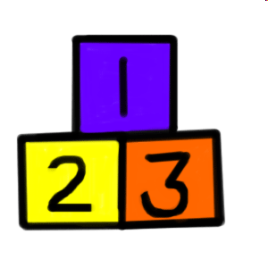
Primitive Data Types: Decimal
For business applications
Essential to COBOL
  C# offers a decimal data type
Store a fixed number of decimal digits
Advantage: accuracy
Disadvantages: Wastes memory

Slide 8
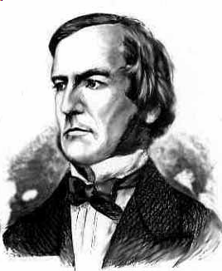
Primitive Data Types: Boolean
Simplest of all
Range of values: two elements, one for “true” and one for “false”
Could be implemented as bits, but often as bytes
  Advantage: readability

Slide 9

Primitive Data Types: Character
Stored as numeric codings
Most commonly used coding: ASCII
ASCII uses the values 0..127 to code 128 different characters.
  Integer and character values can be used interchangeably ?
  char sembol;
int deger;
sembol = ‘A';
…
sembol = ‘B' + 3;
…
deger = ‘N‘;
sembol = deger;

Slide 10

Character String Types
Values are sequences of characters
Design issues:
  Is it a primitive type or just a special kind of array?
  Should the length of strings be static or dynamic?

Slide 11
Character String Types Operations
Typical operations:
  Assignment and copying
  Comparison (=, >, etc.)
  Catenation (or concatenation)
  Substring reference
  Pattern matching

Slide 12
Character String Type in Certain Languages
C and C++
  Not primitive
  Use char arrays and a library of functions that provide operations
SNOBOL4 (a string manipulation language)
  Primitive
  Many operations, including elaborate pattern matching
Java
  Primitive via the String class (??)

Slide 13
Character String Length Options
Static: COBOL, Java’s String class
Limited Dynamic Length: C and C++
  In C-based language, a special character is used to indicate the end of a string’s characters, rather than maintaining the length
Dynamic (no maximum): SNOBOL4, Perl, JavaScript
Ada supports all three string length options

Slide 14
Character String Implementation
Static length: compile-time descriptor
Limited dynamic length: may need a run-time descriptor for length
Dynamic length: need run-time descriptor; allocation/de-allocation is the biggest implementation problem

Slide 15
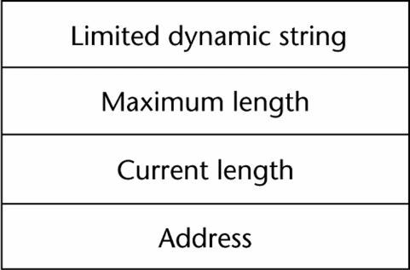
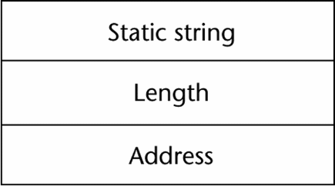
Compile- and Run-Time Descriptors
Run-time descriptor for limited dynamic strings
Compile-time descriptor for static strings

Slide 16
User-Defined Ordinal Types
An ordinal type is one in which the range of possible values can be easily associated with the set of positive integers.
Examples of primitive ordinal types in Java
  integer
  char
  boolean
X < ORDER < Y

Slide 17

Enumeration Types
All possible values, which are named constants, are provided in the definition
C# example
  enum days {mon, tue, wed, thu, fri, sat, sun};

Slide 18
Enumeration Types in Pascal
For ex;
    type colortype = (red, blue, green, yellow)
    var color : colortype;
Two enumeration type variables and literals can be compared with relational operators.
For ex;
    color := blue;
    if (color > red) ....
The result will be true.

Slide 19
Enumeration Types
Design issues
  Is an enumeration constant allowed to appear in more than one type definition, and if so, how is the type of an occurrence of that constant checked?
  Are enumeration values coerced to integer?
  Any other type coerced to an enumeration type?

Slide 20
Evaluation of Enumerated Type
Aid to readability, e.g., no need to code a color as a number
Aid to reliability, e.g., compiler can check:
  operations (don’t allow colors to be added)
  No enumeration variable can be assigned a value outside its defined range
  Ada, C#, and Java 5.0 provide better support for enumeration than C++ because enumeration type variables in these languages are not coerced into integer types

Slide 21
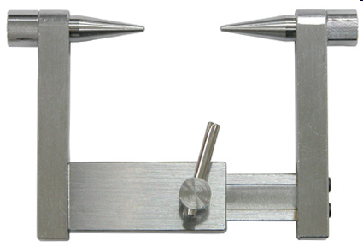
Subrange Types
An ordered contiguous subsequence of an ordinal type
  Example: 12..18 is a subrange of integer type
Ada’s design
  type Days is (mon, tue, wed, thu, fri, sat, sun);
  subtype Weekdays is Days range mon..fri;
  subtype Index is Integer range 1..100;
  Day1: Days;
  Day2: Weekday;
  Day2 := Day1;

Slide 22
Subrange Evaluation
Aid to readability
  Make it clear to the readers that variables of subrange can store only certain range of values
Reliability
  Assigning a value to a subrange variable that is outside the specified range is detected as an error

Slide 23
Implementation of User-Defined Ordinal Types
Enumeration types are implemented as integers
Subrange types are implemented like the parent types with code inserted (by the compiler) to restrict assignments to subrange variables

Slide 24
Array Types
An array is a homogeneous aggregate of data elements in which an individual element is identified by its position in the aggregate, relative to the first element.

Slide 25
Array Design Issues
What types are legal for subscripts?
Are subscripting expressions in element references range checked?
When are subscript ranges bound?
When does allocation take place?
What is the maximum number of subscripts?
Can array objects be initialized?

Slide 26
Array Indexing
Indexing (or subscripting) is a mapping from indices to elements
array_name (index_value_list) → an element
Index Syntax
  FORTRAN, PL/I, Ada use parentheses ( )
  Most other languages use brackets [ ]

Slide 27
Arrays Index (Subscript) Types
FORTRAN, C: integer only
Pascal: any ordinal type (integer, Boolean, char, enumeration)
Ada: integer or enumeration (includes Boolean and char)
Java: integer types only
C, C++, Perl, and Fortran do not specify range checking
Java, ML, C# specify range checking

Slide 28
Subscript Binding and Array Categories
Memory Binding of Arrays:
Static / Stack Dynamic / Dynamic
Subscript Range Binding of Arrays:
Fixed / Variable

Slide 29
Subscript Binding and Array Categories (continued)
C and C++ arrays that include static modifier are static
C and C++ arrays without static modifier are fixed stack-dynamic
Ada arrays can be stack-dynamic
C and C++ provide fixed heap-dynamic arrays (with malloc and free in C, new and delete in C++)
C# includes a second array class ArrayList that provides fixed heap-dynamic
Perl and JavaScript support heap-dynamic arrays

Slide 30
Array Initialization
Some languages allow initialization at the time of storage allocation
  C, C++, Java, C# example
  int list [] = {4, 5, 7, 83}
  Character strings in C and C++
  char name [] = “freddie”;
  Arrays of strings in C and C++
  char *names [] = {“Bob”, “Jake”, “Joe”];
  Java initialization of String objects
  String[] names = {“Bob”, “Jake”, “Joe”};

Slide 31
Arrays Operations
APL provides the most powerful array processing operations for vectors and matrixes as well as unary operators (for example, to reverse column elements)
Ada allows array assignment but also catenation
Fortran provides elemental operations because they are between pairs of array elements
  For example, + operator between two arrays results in an array of the sums of the element pairs of the two arrays

Slide 32
Implementation of Arrays
Access function maps subscript expressions to an address in the array
Access function for single-dimensioned arrays:
address(list[k]) = address (list[lower_bound])
+ ((k-lower_bound) * element_size)

Slide 33
Accessing Multi-dimensioned Arrays
Two common ways:
  Row major order (by rows) – used in most languages
  column major order (by columns) – used in Fortran

Slide 34
Accessing Multi-dimensioned Arrays
For example, if the matrix had the values
  3 4 7
  6 2 5
  1 3 8
It would be stored in row major order as
  3, 4, 7, 6, 2, 5, 1, 3, 8
In column major order, it would be:
  3, 6, 1, 4, 2, 3, 7, 5, 8

Slide 35
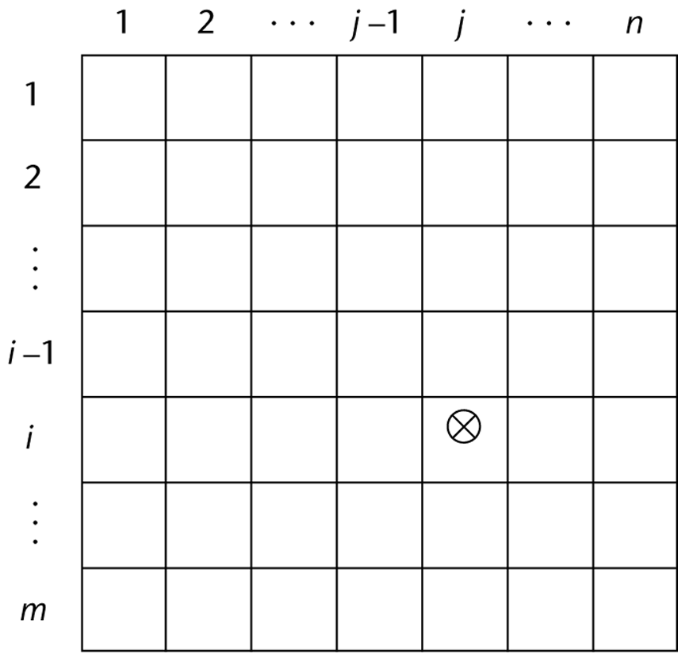
Locating an Element in a Multi-dimensioned Array
General format
  Location (a[i,j]) = address of a [row_lb,col_lb] + (((i - row_lb) * n) + (j - col_lb)) * element_size

Slide 36

Suppose Lower Index Bound is 0
  Location (a[i,j]) = address of a[0,0]
  + ((i*n)+j) * element_size
0
j
n
0
i*n
i
+j
m

Slide 37
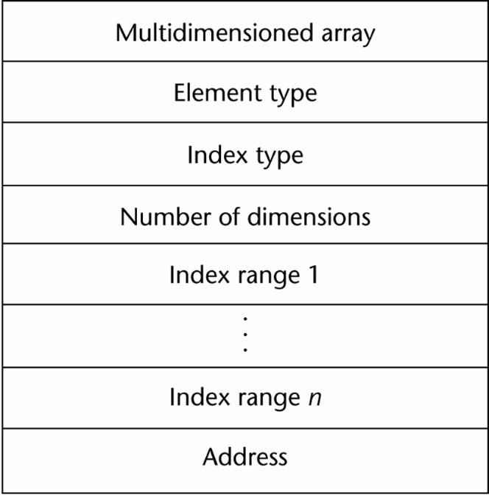
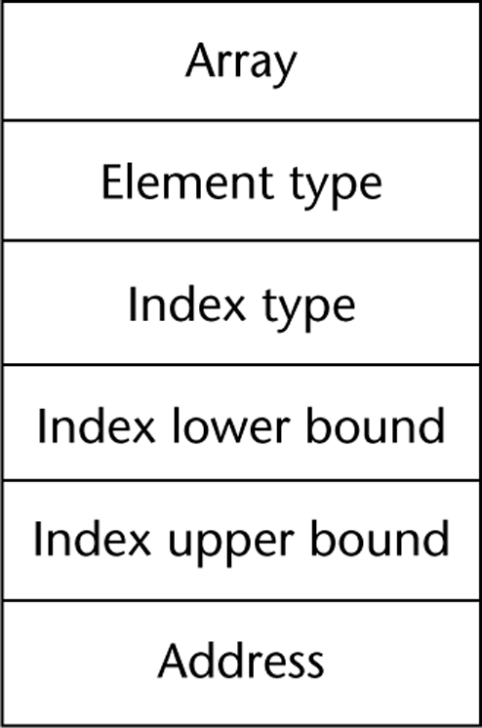
Compile-Time Descriptors
Single-dimensioned array
Multi-dimensional array

Slide 38
Record Types
A record is a possibly heterogeneous aggregate of data elements in which the individual elements are identified by names
Design issues:
  What is the syntactic form of references to the field?
  Are elliptical references allowed
Short-hand writing of field identifiers

Slide 39
Definition of Records
COBOL uses level numbers to show nested records; others use recursive definition
Record Field References
  1. COBOL
  field_name OF record_name_1 OF ... OF record_name_n
  2. Others (dot notation)
  record_name_1.record_name_2. ... record_name_n.field_name

Slide 40
Definition of Records in COBOL
COBOL uses level numbers to show nested records; others use recursive definition
  01 EMP-REC.
  02 EMP-NAME.
  05 FIRST PIC X(20).
  05 MID PIC X(10).
  05 LAST PIC X(20).
  02 HOURLY-RATE PIC 99V99.

Slide 41
Records in Pascal
New languages do not use level numbers in records.
  type personel = record
    ad : array [1..20] of char;
    soyad : array [1..20] of char;
    dogumyil : integer;
  end;
kisiler = array[1..100] of personel

Slide 42
Records in Pascal
The approach used in Pascal for nested record structures is by nesting record declarations inside record declarations.
This approach in Pascal supports orthogonality.

Slide 43
References to Records
Most language use dot notation
  Emp_Rec.Name
Fully qualified references must include all record names
Elliptical references allow leaving out record names as long as the reference is unambiguous, for example in COBOL
FIRST, FIRST OF EMP-NAME, and FIRST of EMP-REC are elliptical references to the employee’s first name

Slide 44
Pascal provides with clause to facilitate references to record fields.
For ex.;
with personel do
  begin
  ad := 'Ali';
  soyad :=‘Taner’;
  dogumyil := 1955;
  end;

Slide 45
Operations on Records
Assignment is very common if the types are identical
Ada allows record comparison
COBOL provides MOVE CORRESPONDING
  Copies a field of the source record to the corresponding field in the target record

Slide 46
Evaluation and Comparison to Arrays
Straightforward and safe design
Records are used when collection of data values is heterogeneous
Access to array elements is much slower than access to record fields, because subscripts are dynamic (field names are static)

Slide 47
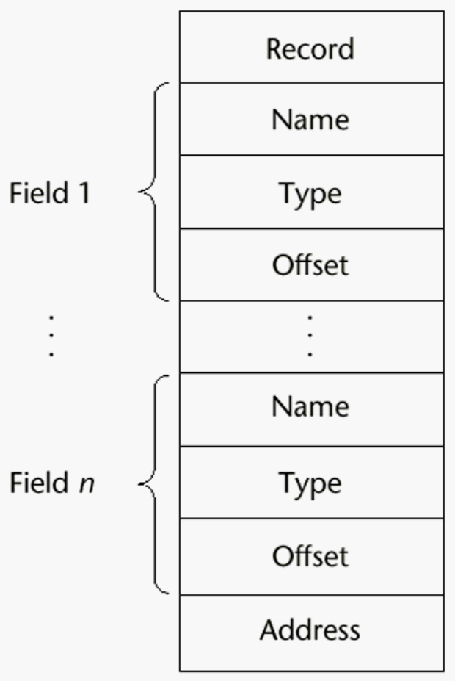
Implementation of Record Type
Offset address relative to the beginning of the records is associated with each field

Slide 48
Union Types
A union is a type whose variables are allowed to store different type values at different times during execution
U n i o n

Slide 49
Variant Records in Pascal
Pascal introduced the concept of integrating unions with record structure.
The union is called a record variant.
  Type odemeturu = (aylik, haftalik);
  Var personel : record
    Personelno: integer;
    Personelad: array [1..20] of char;
  case odeme: odemeturu of
  aylik: (aylikucret:integer);
  haftalik: (haftalikucret:real);
  end;

Slide 50
Discriminated vs. Free Unions
Fortran, C, and C++ provide union constructs in which there is no language support for type checking; the union in these languages is called free union
Type checking of unions require that each union include a type indicator called a discriminant
  Supported by Ada

Slide 51
Ada Union Types
type Shape is (Circle, Triangle, Rectangle);
type Colors is (Red, Green, Blue);
type Figure (Form: Shape) is record
Filled: Boolean;
Color: Colors;
case Form is
when Circle => Diameter: Float;
when Triangle =>
Leftside, Rightside: Integer;
Angle: Float;
when Rectangle => Side1, Side2: Integer;
end case;
end record;

Slide 52
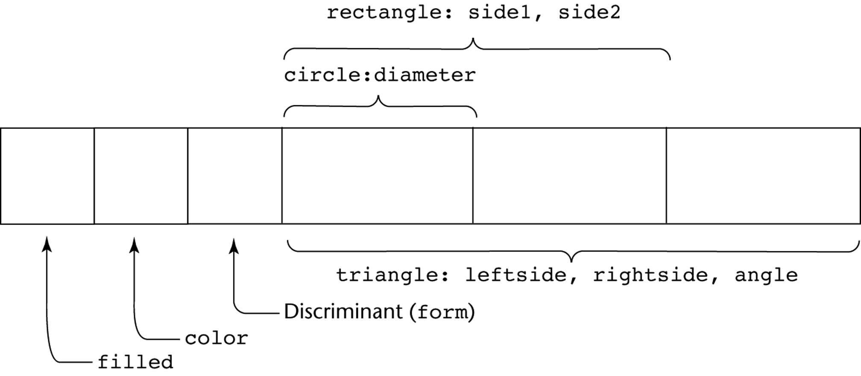
Ada Union Type Illustrated
A discriminated union of three shape variables

Slide 53
Evaluation of Unions
Potentially unsafe construct
  Do not allow type checking
Java and C# do not support unions
  Reflective of growing concerns for safety in programming language

Slide 54

Pointers and References
A Pointer is a value that normally contains the address of a memory location (address of a variable or a constant).

Slide 55
Pointer and Reference Types
A pointer type variable has a range of values that consists of memory addresses and a special value, nil
Provide the power of indirect addressing
Provide a way to dynamically manage memory
A pointer can be used to access a location in the area where storage is dynamically created (usually called a heap)

Slide 56
Design Issues of Pointers
What are the scope of and lifetime of a pointer variable?
What is the lifetime of a heap-dynamic variable?
Are pointers restricted as to the type of value to which they can point?
Are pointers used for dynamic storage management, indirect addressing, or both?
Should the language support pointer types, reference types, or both?

Slide 57
Pointers
Pointers are specified using a type operator;
  * in C and C++ (*ptr )
  ^ in Pascal. (ptr ^)
Languages that include a pointer type include two fundamental pointer operations:
  Assignment
  Dereferencing.

Slide 58
Pointer Operations
Two fundamental operations: assignment and dereferencing
Assignment is used to set a pointer variable’s value to some useful address
  By an operator or a built-in subprogram
Dereferencing yields the value stored at the location represented by the pointer’s value
  C++ uses an explicit operation via *
    j = *ptr
    sets j to the value located at ptr
  In Pascal, Dereferencing can be explicitly specified with the ^ operator.
    j := ptr ^

Slide 59
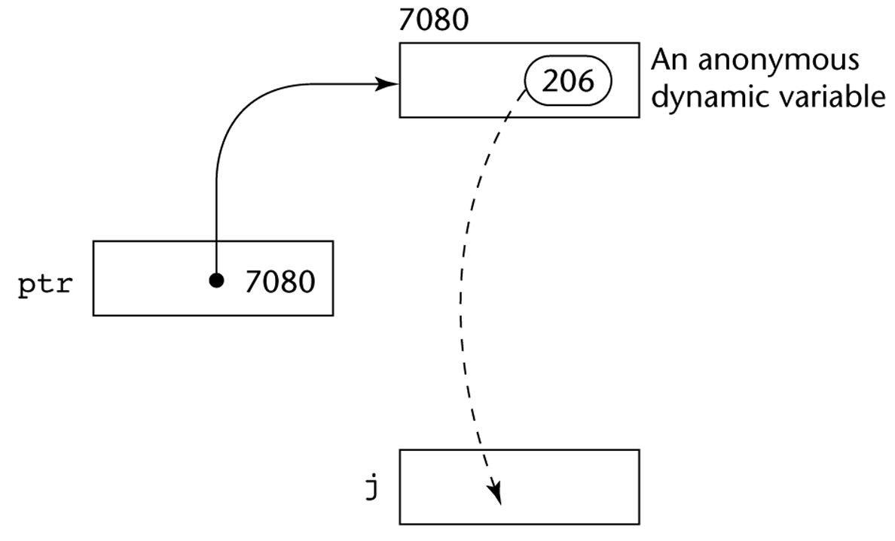
Pointer Assignment Illustrated
The assignment operation j = *ptr

Slide 60
For example;
    int *ptr;
    int sayac, toplam;
    .....
    ptr = &toplam;
    sayac = *ptr;
Is the same as writing:
  sayac = toplam;

Slide 61
Pointers in PL/I
PL/I was the first high-level programming language that included pointer variables.
Very flexible, but open to programming errors.
    A PL/I pointer is not restricted to a single domain type to point.
    A dangling pointer, is a pointer that contains the address of a dynamic variable that has been deallocated.

Slide 62
Problems with Pointers
Dangling pointers (dangerous)
  A pointer points to a heap-dynamic variable that has been de-allocated
Lost heap-dynamic variable (Lost object)
  An allocated heap-dynamic variable that is no longer accessible to the user program (often called garbage)
    Pointer p1 is set to point to a newly created heap-dynamic variable
    Pointer p1 is later set to point to another newly created heap-dynamic variable

Slide 63
Dangling pointers -1
A dangling pointer can occur if the scope of a pointer is larger than that of the object to which it points.
For example;
      BEGIN;
      DECLARE AA POINTER;
      .....
      BEGIN;
        DECLARE toplam FIXED DEC(5,0);
        AA = ADDR(toplam);
        .....
      END;
      ....
      END;
AA is a dangling pointer after exiting the block because toplam is a local variable

Slide 64
Dangling Pointers -2
A second way to create dangling pointers is because of the deallocation of dynamic variables.
For ex;
  DECLARE toplam FIXED DEC(5,0) BASED (AA);
  DECLARE BB POINTER;
  .......
  ALLOCATE toplam;
  BB = AA;
  FREE toplam;
Pointer assignment

Slide 65
Dangling Pointers -3
int *a, *b;
…
a = malloc(sizeof (int));
b = a;
free(a);

Slide 66
Pointers in Ada
Some dangling pointers are prevented because dynamic objects can be automatically de-allocated at the end of pointer's scope. (optional)
The lost heap-dynamic variable problem is not eliminated by Ada
(Can be made by alocating a pointer twice)

Slide 67
Pointers in C and C++
Extremely flexible but must be used with care
Pointers can point at any variable regardless of when it was allocated
Used for dynamic storage management and addressing
Pointer arithmetic is possible
Explicit dereferencing and address-of operators
Domain type need not be fixed (void *)
void * can point to any type and can be type checked (cannot be de-referenced)

Slide 68
Pointers in C and C++
When pointers point to records, there are two ways:
  If a pointer variable p points to a record with a field named toplam,
    (*p).toplam can be used to refer that field.
  The operator ->, when used between a pointer to a record and a field of that record, it combines dereferencing and field reference.
    For example, the expression p -> toplam is equivalent to (*p). toplam.

Slide 69
Pointers in C
Example:
-> usage
struct aa{
int sayac;
char* ad;
  };
struct aa *gosterge;
gosterge = (struct aa *) malloc (sizeof (struct aa));
gosterge->sayac = 101;
gosterge->ad = “ABC”;

Slide 70
Pointer Arithmetic in C and C++
There is also close relation between pointers and arrays in C
float stuff[100];
float *p;
p = stuff;
*(p+5) is equivalent to stuff[5] and p[5]
*(p+i) is equivalent to stuff[i] and p[i]

Slide 71
For ex:
int dizi[10];
int *ptr;
ptr = dizi;
assigns the address of dizi[0] to ptr. (an array name without a subscript shows the base address of the array.)
So:
  *(ptr + 1) is equivalent to dizi[1]
  *(ptr + index) is equivalent to dizi[index]
  ptr[index] is equivalent to dizi[index]

Slide 72
Reference Types
C++ includes a special kind of pointer type called a reference type that is used primarily for formal parameters
  Advantages of both pass-by-reference and pass-by-value (?)
Java extends C++’s reference variables and allows them to replace pointers entirely.
C# includes both the references of Java and the pointers of C++

Slide 73
Evaluation of Pointers
Dangling pointers and lost objects are problems
The ability to manage the memory (heap) is an asset.
Pointers or references are necessary for dynamic data structures--so we can't design a language without them

Slide 74
Representations of Pointers
Large computers use single values
Intel microprocessors use segment and offset

Slide 75
Dangling Pointer Problem
Tombstone: extra heap cell that is a pointer to the heap-dynamic variable
  The actual pointer variable points only at tombstones
  When heap-dynamic variable de-allocated, tombstone remains but set to nil
  Costly in time and space
.

Slide 76


Locks-and-keys:
Pointer values are represented as (key, address) pairs
  Heap-dynamic variables are represented as variable plus cell for integer lock value
  When heap-dynamic variable allocated, lock value is created and placed in lock cell and key cell of pointer
Pointer only works if lock and key matches.
So nothing is dangling…

Slide 77
Heap Management
A very complex run-time process
Single-size cells vs. variable-size cells
Two approaches to reclaim garbage
  Reference counters (eager approach): reclamation is gradual
  Garbage collection (lazy approach): reclamation occurs when the list of variable space becomes empty

Slide 78
Reference Counter
Reference counters: maintain a counter in every cell that store the number of pointers currently pointing at the cell
  Disadvantages: space required, execution time required, complications for cells connected circularly

Slide 79
Garbage Collection
The run-time system allocates storage cells as requested and disconnects pointers from cells as necessary; garbage collection then begins
  Every heap cell has an extra bit used by collection algorithm
  All cells initially set to garbage
  All pointers traced into heap, and reachable cells marked as not garbage
  All garbage cells returned to list of available cells
  Disadvantages: when you need it most, it works worst (takes most time when program needs most of cells in heap)

Slide 80
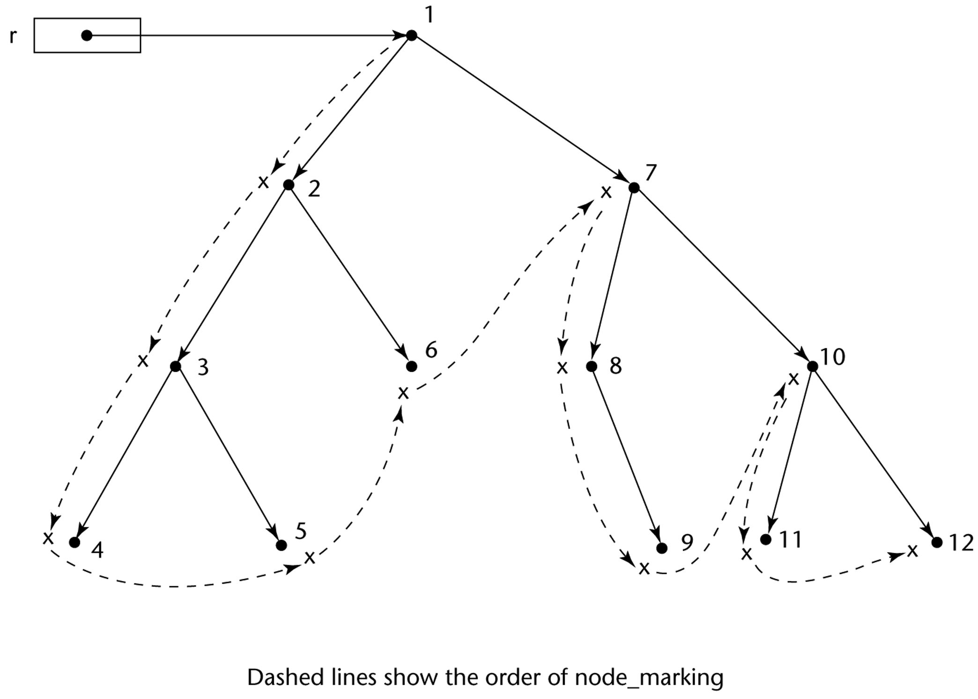
Marking Algorithm

